Slide 1
Outsider inspection system with it
Prayook Jatesiktat
Kasetsart University
Notes:
Name
Department
Kasetsart
My Project

Slide 2

Review Problems
Low efficient screening.
Blacklist
Permanent card warning
Anyone who want to trade temporary card
Conclude & report data.
Consume much time.
some case of process.
Cannot integrate with other systems.
Notes:
Follow the slide

Slide 3

System Features

Slide 4








Flexible Structure
Correspond with existing database
Easy installation
Always up-to-date application
Extendable
Notes:
Flexible Web-Based Structure.
Make this application do the following things.
Now, database of this application are binding with some path of existing database. Nothing conflict.
Second, this structure provide easy installation at any client , just install a small tool at the first time of usages in two minute.
After that users will get the last updated application from the server.
So this environment allow developer to update and extend this system easily.

Slide 5



Support All Existing Process
Check In
Check Out
Visitor
Contractor*
Notes:
Checking IN and OUT for visitor and contractor
BUT in case of contractor, the designed system can support but not practical in real situation that some group of contractors have up to fifty persons. This system is too slow to service, But I will discuss the prepared solution at the last section of this presentation.

Slide 6




Screening
Blacklist Management
Temporary Card Management
Blacklist
Notes:
Blacklist management
Add, Edit, Delete Blacklist Data
Can alert security guard when someone in blacklist check in
Temporary Card Management
Can alert when someone could not entrance the company because
he not pass the exam or
Making of his permanent card come to deadline

Slide 7

Reporting
From any joined-domain-PC
Real time
Coming History
Card Image
Notes:
Thanks to the web-based structure that make any joined domain computer to access this application to view report at any time.
Which this report contain outsider profile, card image and his in and out history.

Slide 8

Permission Management
Who can …
Access this application?
Manage blacklist?
Make transaction?
Notes:
And the last feature is permission management
This feature allow administrator to screen user about …

Slide 9

Demonstration
Let’s see

Slide 10
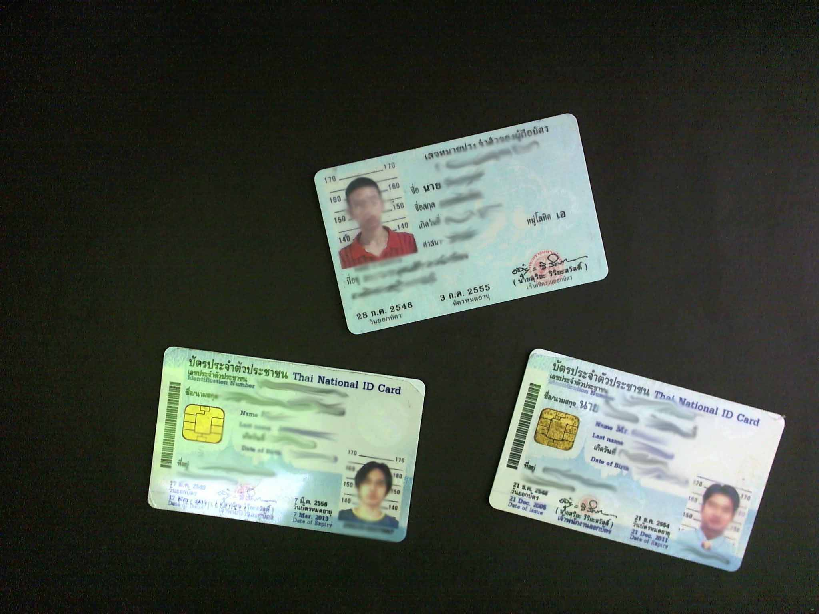
Example of input image.

Slide 11

Significant Problems
not enough time for full system test.
steep learning curve for next developer.
Light control.
capture bigger area for more cards give lower accuracy.
Notes:
First problem is I have not enough time for full system test, so this system could not hastily deploy without a developer that can fix system quickly when the problems occur.
This problem is strongly binding with the next problem. I develop this application using the Silverlight tool which is new for everyone in IT section and I estimate that learning Silverlight spend at least 3 weeks and understanding all of the code in my project may spend about 1 week. So all of the learning process may consume about 1 month before this application can deploy without big problem. I try to make this learning shorter by spend this week with transferring project structure and Silverlight tool usage to someone.
The next problem is light control
I create this light box for control all of the light and make application more stable
but it’s not enough. This box must make more closing environment.
And another problem is lower digit recognition accuracy when try to capture more cards at the same time. This problem limit the maximum numbers of cards at 4 cards per capturing.

Slide 12

Future Works
More practical contractor management system
Pre-register process (with web application)
Contractor permanent card providing system
Improve screening to 100%
Everyone(insider & outsider) can check-in and check-out in very short time.
QR Code
Barcode
RFID
Extend to other entrances.
Easy with web-based application
Extend to other company.
Shared blacklist management system.
Notes:
First step is making More practical contractor management system
By change process to Pre-register process with web application to decrease process time of registration at company entrance
*Card providing system : this system can print new contractor cards when they pass the exam. This system can cancel all of the temporary process because they will get permanent card immediately.
If card providing system is success, SMPC will be able to control the standard of contractor card and this is the way to improve screening to full control, because it’s easy to design any technology in that card like QR Code, Barcode or RFID
This will make checking in easier in case of contractor.
-And the next phase is extending this system to other entrance
-And the last step is extending to other companies and share blacklist management system among them.

Slide 13
Q&A

Slide 14
Thanks
Notes:
ขอบคุณ
พี่ๆฝ่ายๆ IT ที่คอยให้ความบันเทิงขณะทำงานอยู่ตลอด
ขอบคุณพี่ไพศาล สำหรับการติดตั้ง server ให้ และความรู้เกี่ยวกับการถ่ายภาพ
ขอบคุณพี่มีมี่ และ พี่หุน สำหรับ Idea มากมายในการสร้าง ระบบ
ขอบคุณพี่ฝ่ายซ่อมคนหนึ่ง ที่ช่วยทำ lightbox ใบนี้ให้
ขอบคุณทุกคนที่พาไปเลี้ยงข้าว
ขอบคุณทุกคนที่กดดันจนงานคืบหน้าไปได้มากขนาดนี้ครับ

Slide 15
Backup Slides

Slide 16
Target
 | Before | After
Process time | 2 min | 2 min
Blacklist detection | 1 Hour | 1 min
Trace back history | cannot | 1 min
Real-time report | cannot | 1 min
Paper usage reduction | - | -50%

Slide 17
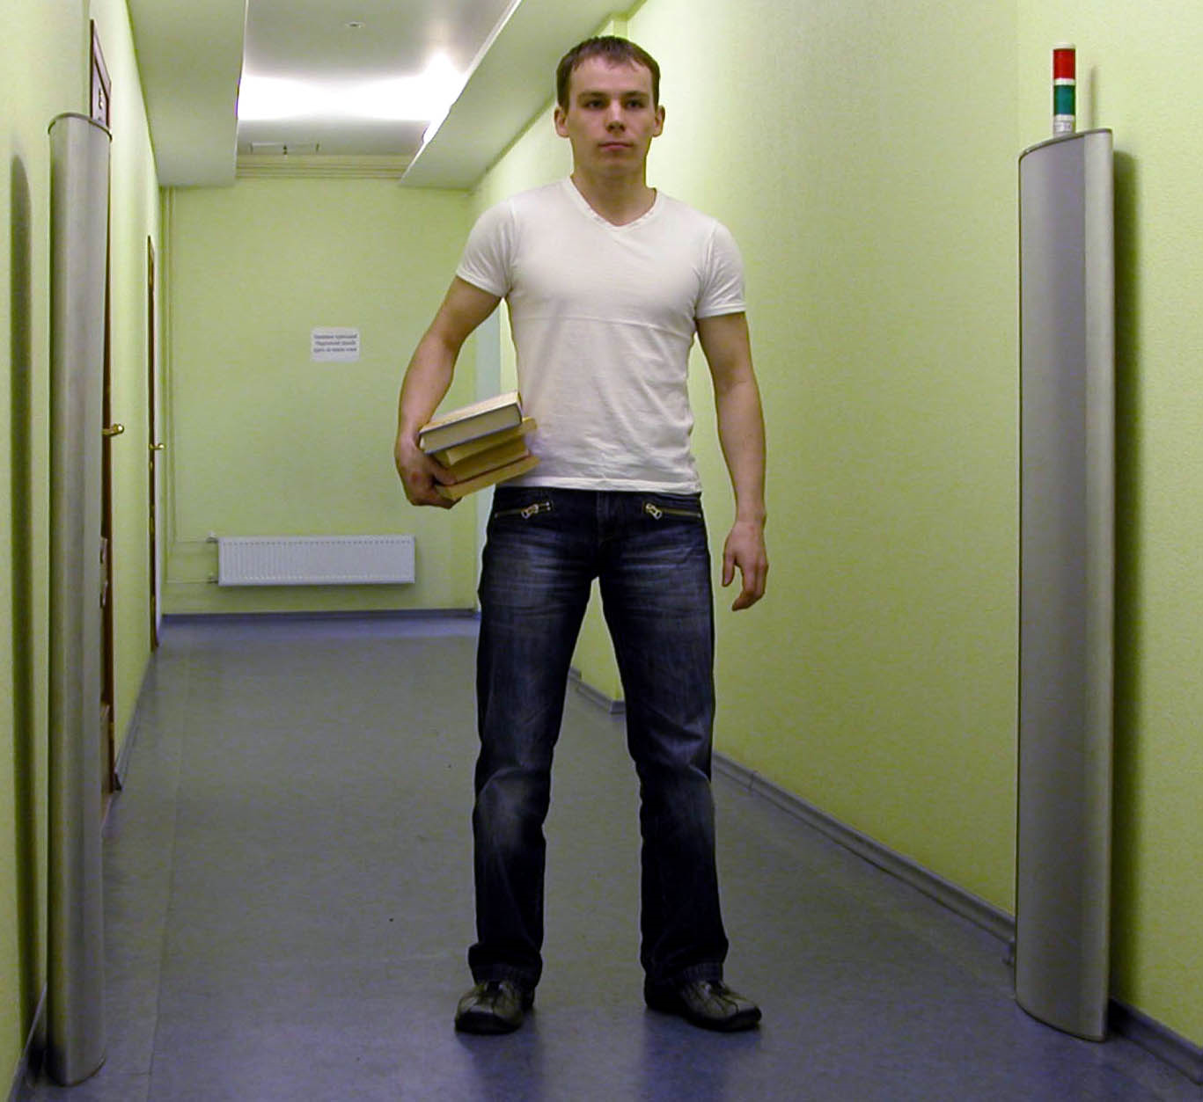
RFID reader

